Slide 1
Comparison of Clustering Algorithms
By: Hamed Khashehchi
Data Mining Dr. Ali Ahmadi

Slide 2
Data
Noisy Circles
Noisy Moons
Blobs
Aniso
Random
Digits
Iris

Slide 3
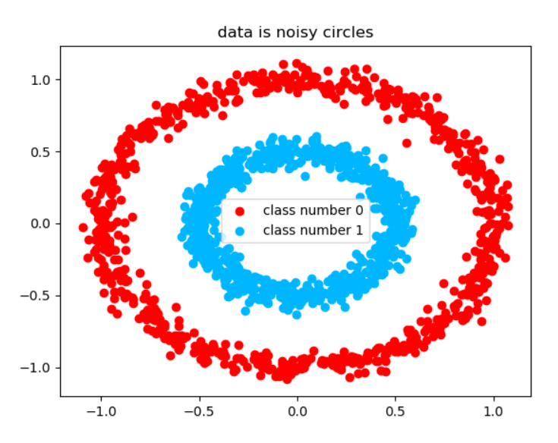
Noisy Circles
Make a large circle containing a smaller circle in 2d
Scale between inner and outer circle

Slide 4
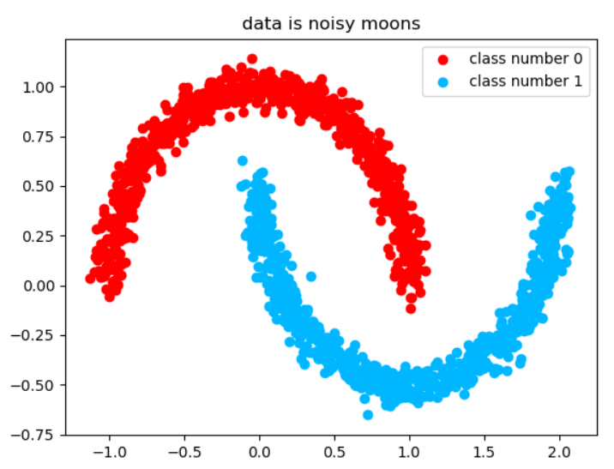
Noisy Moons
Make two interleaving half circles

Slide 5
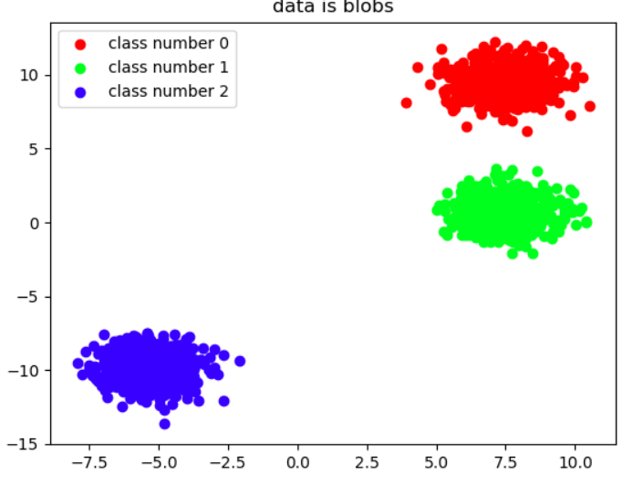
Blobs
Generate isotropic Gaussian blobs for clustering

Slide 6
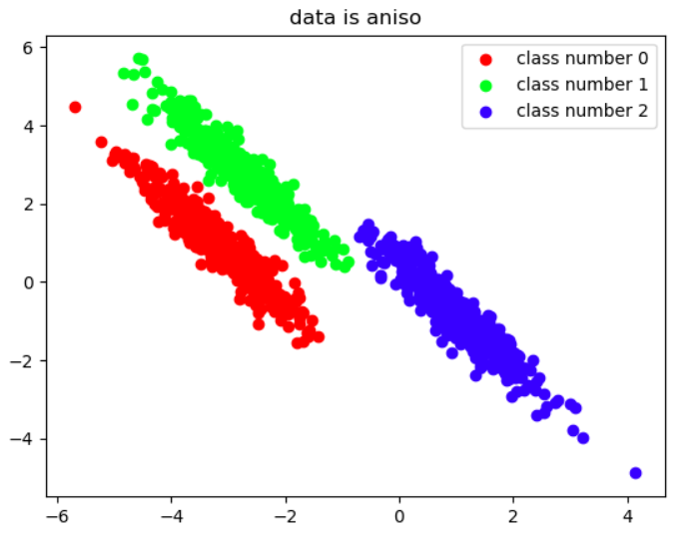
anisotropic distribution
Transferred Blobs

Slide 7
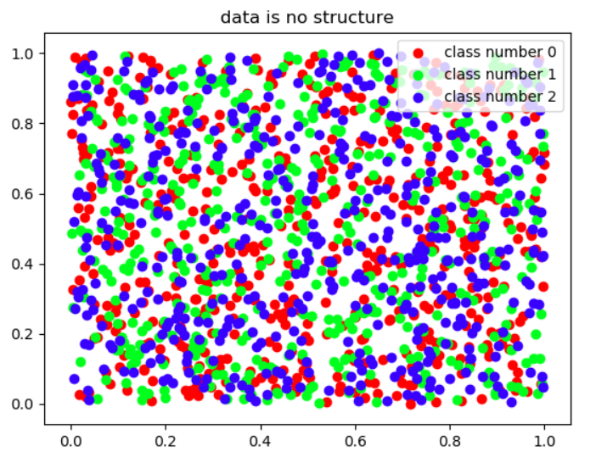
Random data
Uniform data

Slide 8
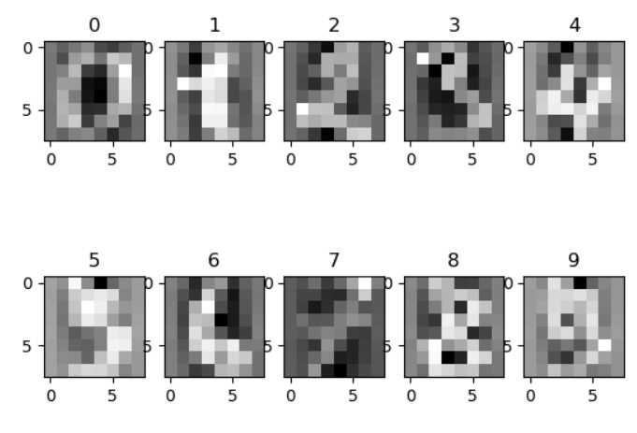
Digits
Hand written digits

Slide 9
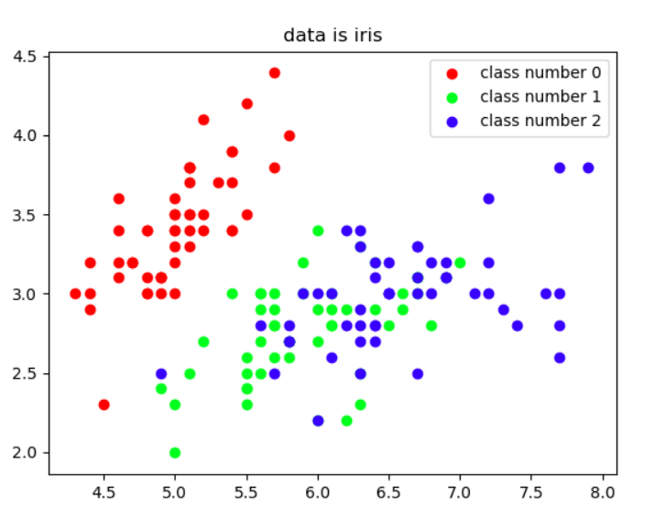
Iris
Flower classification/clustering

Slide 10
Algorithms
K-means
DBSCAN
Birch
Agglomerative Clustering
Affinity Propagation
SOM

Slide 11
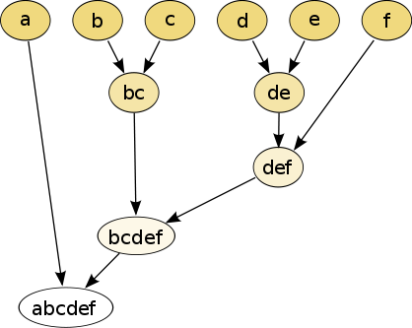
Agglomerative Clustering
Ensure nearby points end up together
N singleton clusters
Repeat until convergence (1 cluster remaining)
Find a pair of clusters that are closest
Merge them
Delete beforehand, Add after that
Choosing threshold

Slide 12
Affinity Propagation
centroid based clustering algorithm
does not require the estimation of the number of clusters
takes as input the similarities between the data points and identifies
Messages are exchanged between the data points

Slide 13

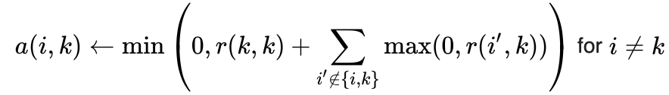
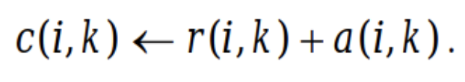
Affinity Propagation
Similarity matrix
S(i , j)= -||xi-xj||²
Responsibility matrix
r(i , k) quantifies how well-suited element k is, to be an exemplar for element i
Availability matrix
a(i , k) quantifies how appropriate is it for i to choose k as its exemplar
Criterion matrix
The element with the highest criterion value in each row would be designated to be an exemplar

Slide 14
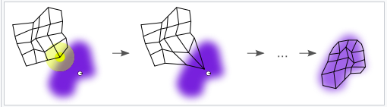
SOM
A self-organizing map is a 2D representation of a multidimensional dataset.
competitive learning as opposed to error correlated learning
In competitive learning, nodes compete for the right to respond to the input data subset

Slide 15
SOM
The Euclidean distance to all weight vectors is computed when we feed the training data into the network
The weights of the BMU and neurons close to it in the SOM grid are adjusted towards the input vector

Slide 16
SOM
1. Initialize the weights for each node. The weights are set to small standardized random values.
2. Choose a vector at random from the training set and present to the lattice.
3. Examine every node to calculate which one’s weight is most like the input vector. This will allow you to obtain the Best Matching Unit (BMU). We compute the BMU by iterating over all the nodes and calculating the Euclidean distance between each node’s weight and the current input vector. The node with a weight vector closest to the input vector is marked as the BMU.
4. Calculate the radius of the neighborhood of the BMU. Nodes found within the radius are deemed to be inside the neighborhood of the BMU.
5. Weights of the nodes found in step 4 are adjusted to make them more like the input vector. The weights of the nodes closer to the BMU are adjusted more.
6. Repeat step 2 for N iterations

Slide 17
Comparison Measures
Homogeneity
A clustering result satisfies homogeneity if all of its clusters contain only data points which are members of a single class
Completeness
A clustering result satisfies completeness if all the data points that are members of a given class are elements of the same cluster
Jaccard
defined as the size of the intersection divided by the size of the union of two label sets
Normalized Mutual Information
normalization of the Mutual Information (MI) score to scale the results between 0 (no mutual information) and 1 (perfect correlation)
Silhouette score
average distance to elements in the same cluster with the average distance to elements in other clusters

Slide 18
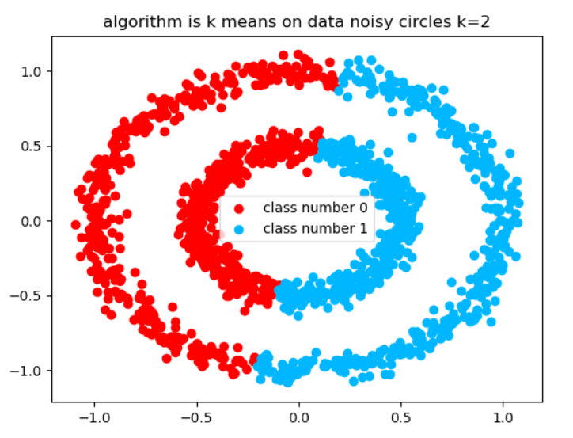
K Means
K = cluster
Noisy Circles
homogeneity score: 0.00
completeness score: 0.00
jaccard score: 0.49
normalized mutual information score: 0.0
silhouette score: 0.35

Slide 19
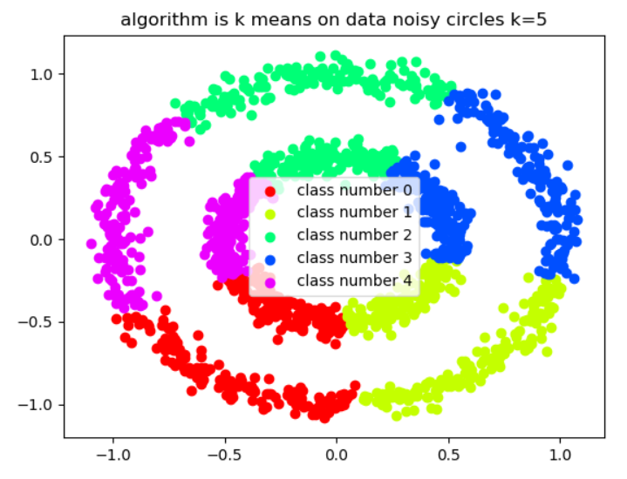
K means
K = 5
Noisy Circles
homogeneity score: 0.00
completeness score: 0.00
jaccard score: 0.20
normalized mutual information score: 0.0
silhouette score: 0.36

Slide 20
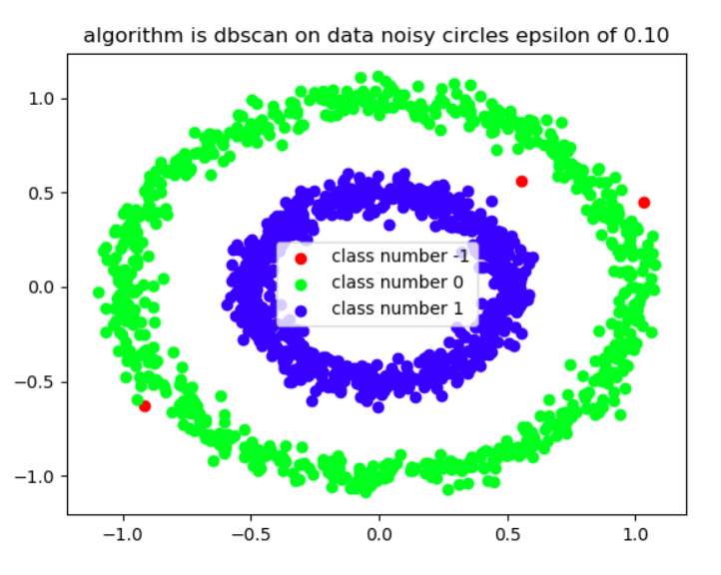
DBSCAN
Eps = 0.1
Noisy Circles
homogeneity score: 1.00
completeness score: 0.98
jaccard score: 1.00
normalized mutual information score: 0.99
silhouette score: 0.09

Slide 21
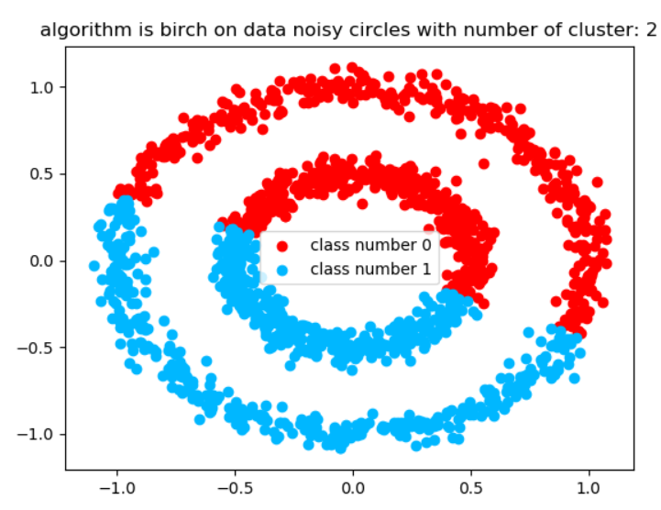
Birch
Number of cluster same as true
Noisy Circles
homogeneity score: 0.00
completeness score: 0.00
jaccard score: 0.50
normalized mutual information score: 0.0
silhouette score: 0.35

Slide 22
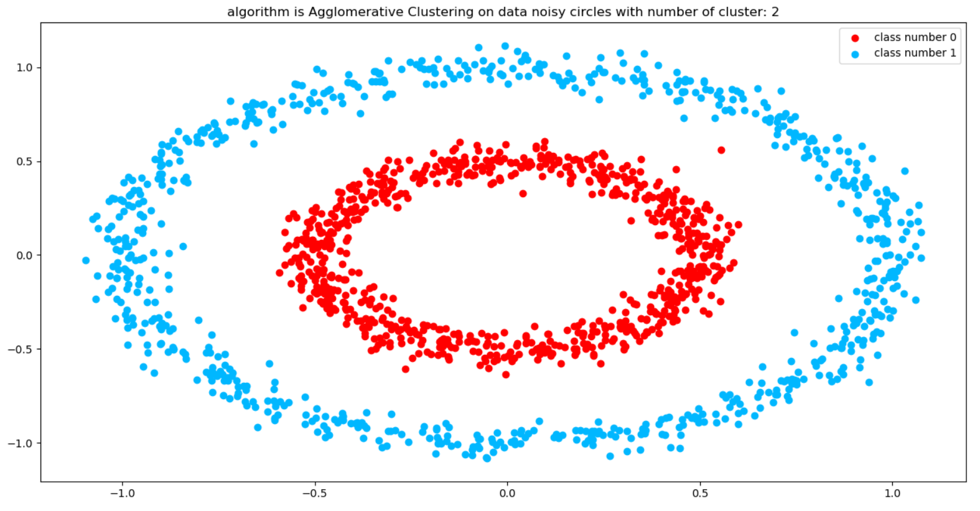
Agglomerative Clustering
Noisy Circles
homogeneity score: 0.99
completeness score: 0.99
jaccard score: 0.00
normalized mutual information score: 0.99
silhouette score: 0.11

Slide 23
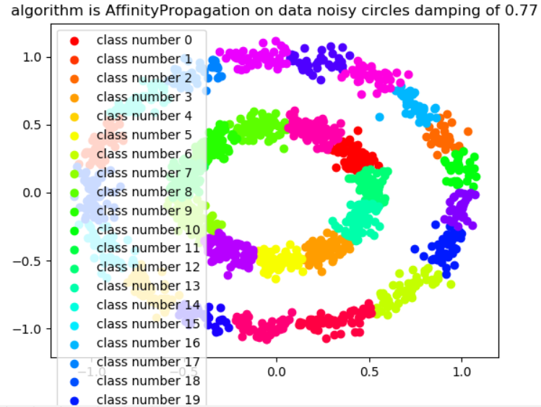
Affinity Propagation
Noisy Circles
homogeneity score: 1.00
completeness score: 0.21
jaccard score: 0.00
normalized mutual information score: 0.46
silhouette score: 0.47

Slide 24
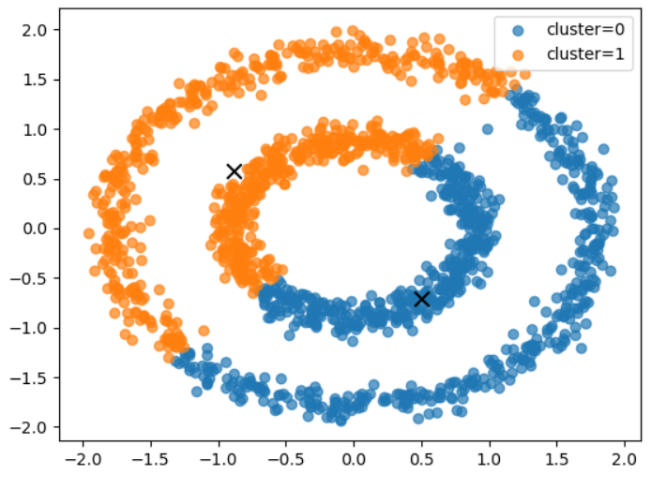
SOM
Noisy Circles
homogeneity score: 0.00
completeness score: 0.00
jaccard score: 0.49
normalized mutual information score: 0.00
silhouette score: 0.35

Slide 25
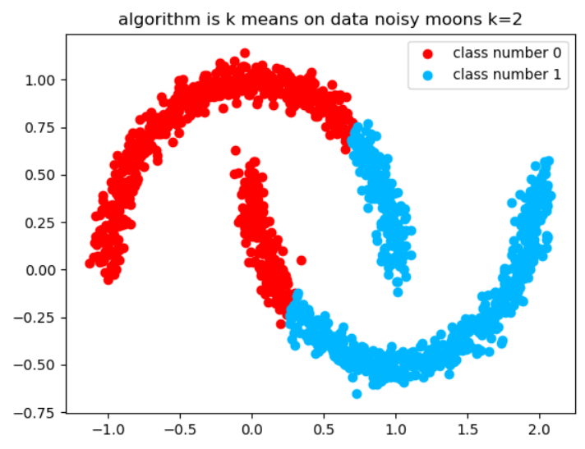
K Means
K = cluster
Noisy Moons
homogeneity score: 0.19
completeness score: 0.19
jaccard score: 0.75
normalized mutual information score: 0.19
silhouette score: 0.49

Slide 26
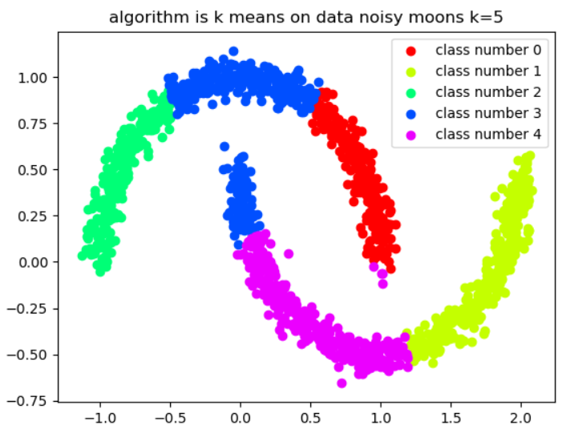
K means
K = 5
Noisy Moons
homogeneity score: 0.79
completeness score: 0.34
jaccard score: 0.37
normalized mutual information score: 0.52
silhouette score: 0.49

Slide 27
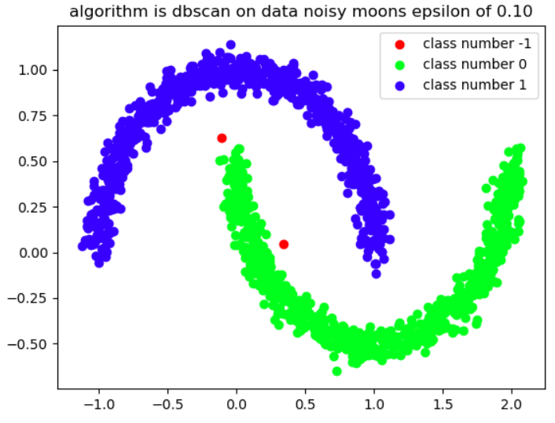
DBSCAN
Eps = 0.1
Noisy Moons
homogeneity score: 1.00
completeness score: 0.99
jaccard score: 0.00
normalized mutual information score: 0.99
silhouette score: 0.01

Slide 28
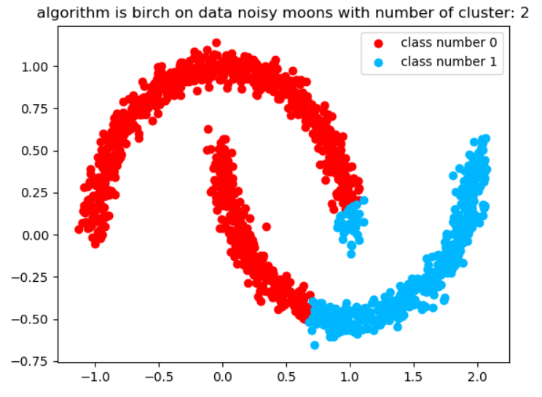
Birch
Number of cluster same as true
Noisy Moons
homogeneity score: 0.27
completeness score: 0.30
jaccard score: 0.77
normalized mutual information score: 0.28
silhouette score: 0.46

Slide 29
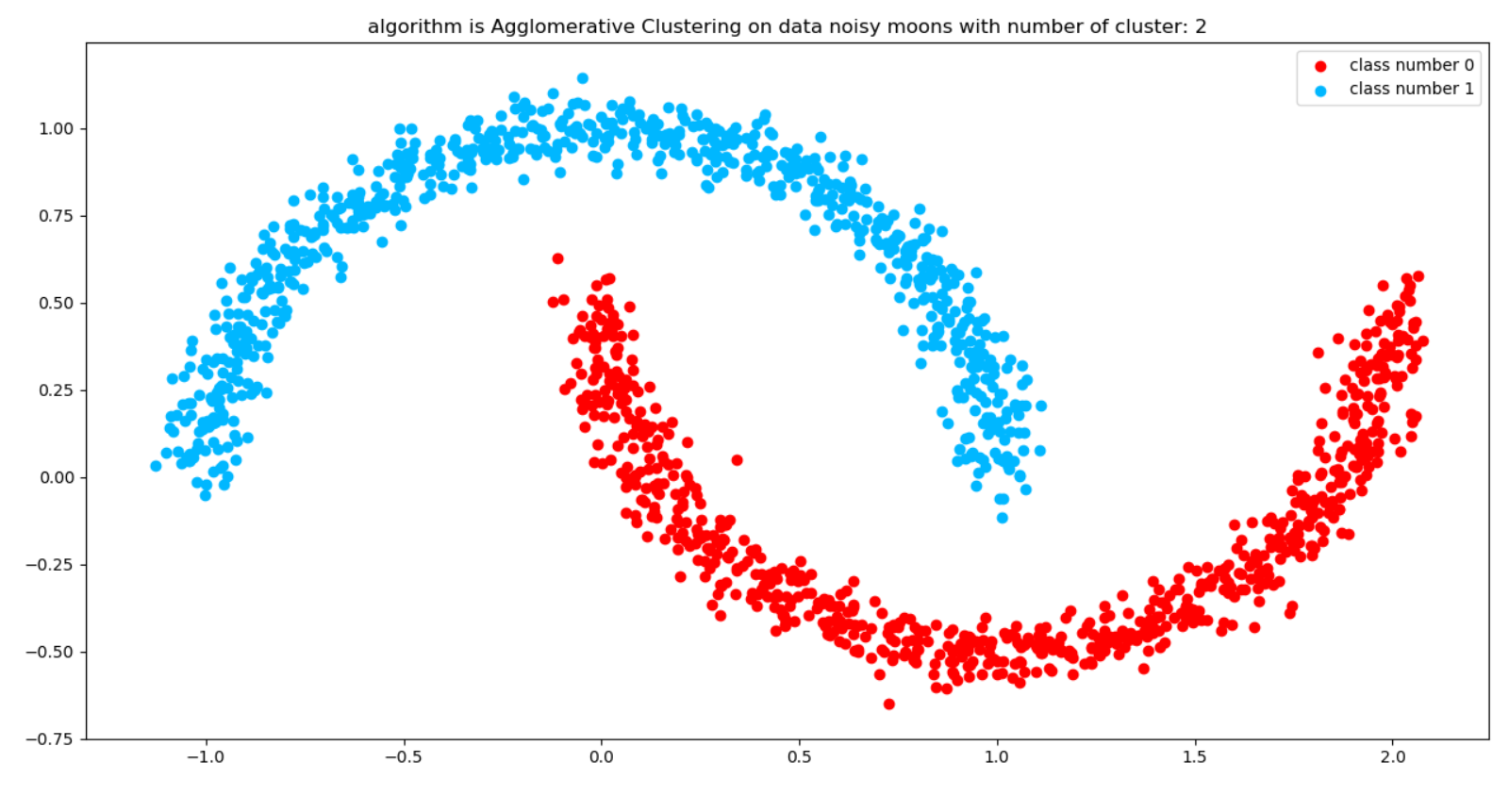
Agglomerative Clustering
Noisy Moons
homogeneity score: 1.00
completeness score: 1.00
jaccard score: 0.00
normalized mutual information score: 1.00
silhouette score: 0.33

Slide 30
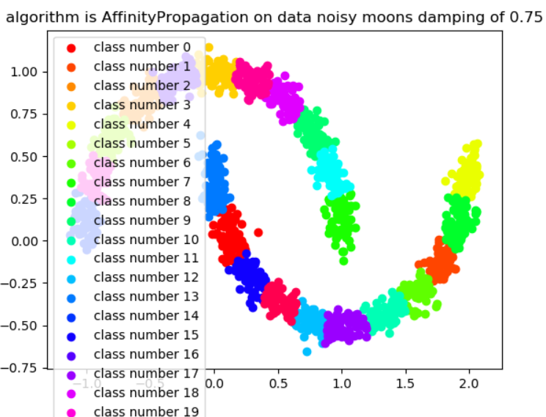
Affinity Propagation
Noisy Moons
homogeneity score: 1.00
completeness score: 0.22
jaccard score: 0.04
normalized mutual information score: 0.47
silhouette score: 0.45

Slide 31
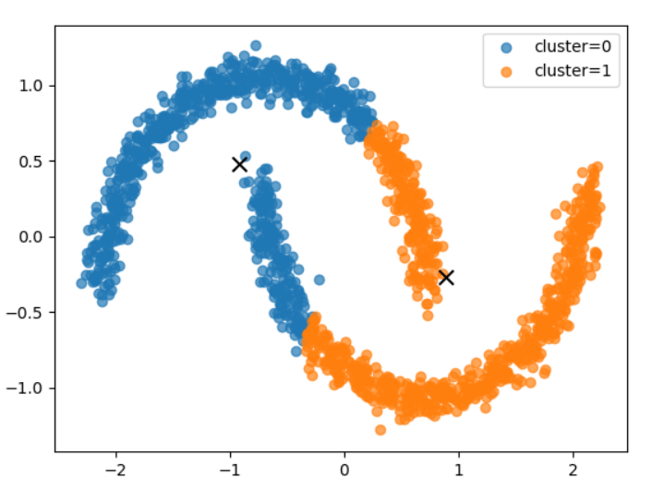
SOM
Noisy Moons
homogeneity score: 0.18
completeness score: 0.18
jaccard score: 0.75
normalized mutual information score: 0.18
silhouette score: 0.49

Slide 32
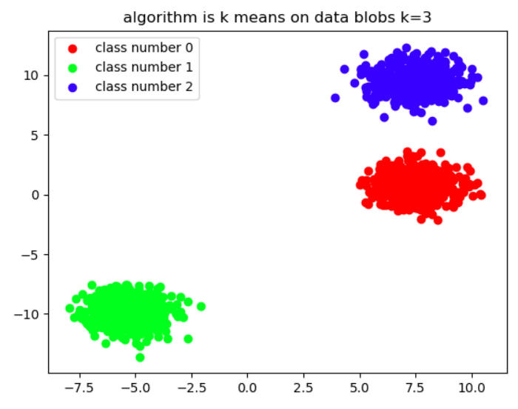
K Means
K = cluster
Blob
homogeneity score: 1.00
completeness score: 1.00
jaccard score: 0.00
normalized mutual information score: 1.00
silhouette score: 0.83

Slide 33
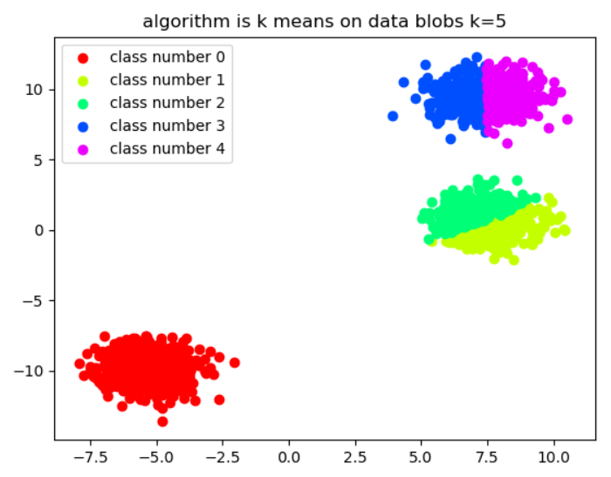
K means
K = 5
Blob
homogeneity score: 1.00
completeness score: 0.70
jaccard score: 0.17
normalized mutual information score: 0.84
silhouette score: 0.50

Slide 34
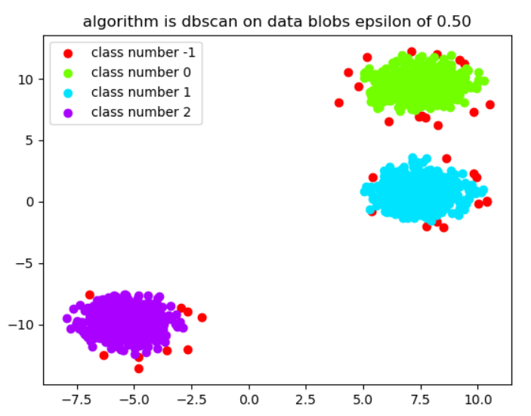
DBSCAN
Eps = 0.1
Blob
homogeneity score: 0.98
completeness score: 0.91
jaccard score: 0.98
normalized mutual information score: 0.94
silhouette score: 0.80

Slide 35
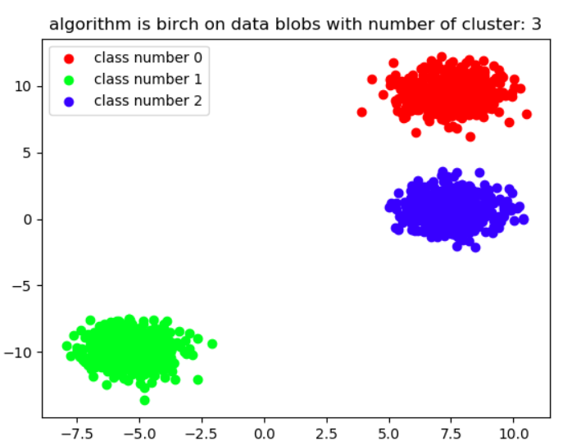
Birch
Number of cluster same as true
Blob
homogeneity score: 1.00
completeness score: 1.00
jaccard score: 0.33
normalized mutual information score: 1.00
silhouette score: 0.83

Slide 36
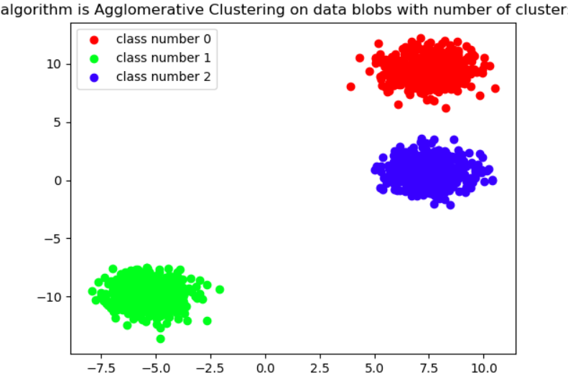
Agglomerative Clustering
Blob
homogeneity score: 1.00
completeness score: 1.00
jaccard score: 0.33
normalized mutual information score: 1.00
silhouette score: 0.83

Slide 37
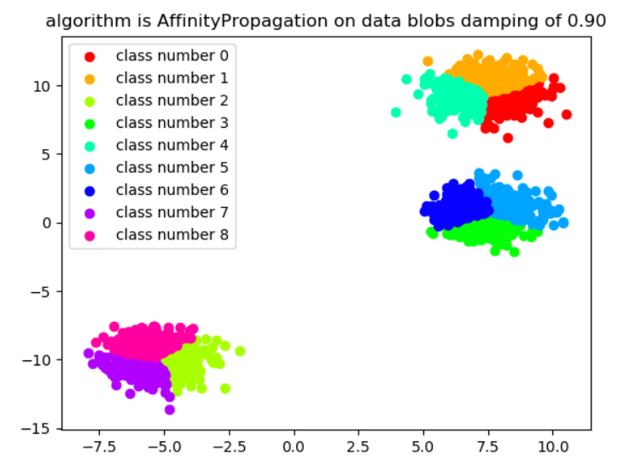
Affinity Propagation
Blob
homogeneity score: 1.00
completeness score: 0.50
jaccard score: 0.23
normalized mutual information score: 0.71
silhouette score: 0.34

Slide 38
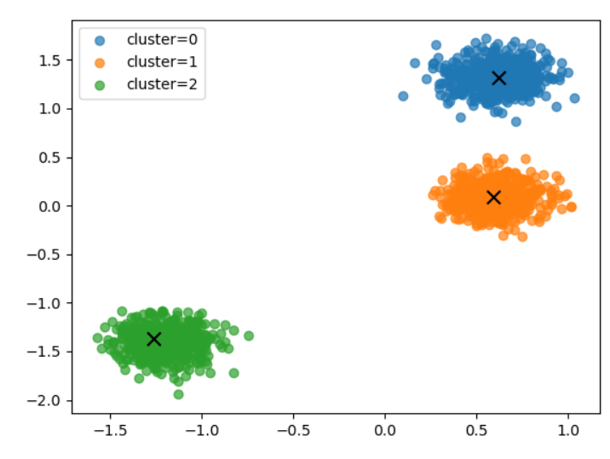
SOM
Blob
homogeneity score: 1.00
completeness score: 1.00
jaccard score: 1.00
normalized mutual information score: 1.00
silhouette score: 0.83

Slide 39
Time to Run the Code

Slide 40
Thanks for your attention

